Slide 1
GROUP 2 Milestone #2

Slide 2
Scope
Milestone #1 | Importance of Big Data Security Big Data Security Technologies
Milestone #2 | Big Data Security Risk
Milestone #3 | Big Data Security Use Cases
Milestone #4 | Big Data Security Issues Regulations and Policies
Milestone #5 | Implementation Part 1
Milestone #6 | Implementation Part 2
Milestone #7 | Implementation Part 3
Notes:
Notes:
Fake Data is one of the biggest challenges of Big Data in today’s world. No matter what state of the art system you implement to process the data and how much money and infrastructure you spend on your organization, it would be totally futile if the data that is to be processed is fake. This fake data is a significant security threat because it also reduces the ability of the organization to identify other important issues. It could lead to several false positives which would in turn cause the organization to waste money and resources.
References:
Smallcombe, M. (2020, June 24). 11 Big Data Security Concerns. Xplenty. https://www.xplenty.com/blog/big-data-security-concerns/
Bekker, A. (2021, May 31). Buried under big data: security issues, challenges, concerns. ScienceSoft. https://www.scnsoft.com/blog/big-data-security-challenges

Slide 3
Agenda
Discuss the Second Milestone.
Big Data Security Risks
Discuss the 9 Big Data Security Concerns.
Discuss the second Milestone
Big Data Security Risks
Top 10 Big Data Security Concerns

Slide 4
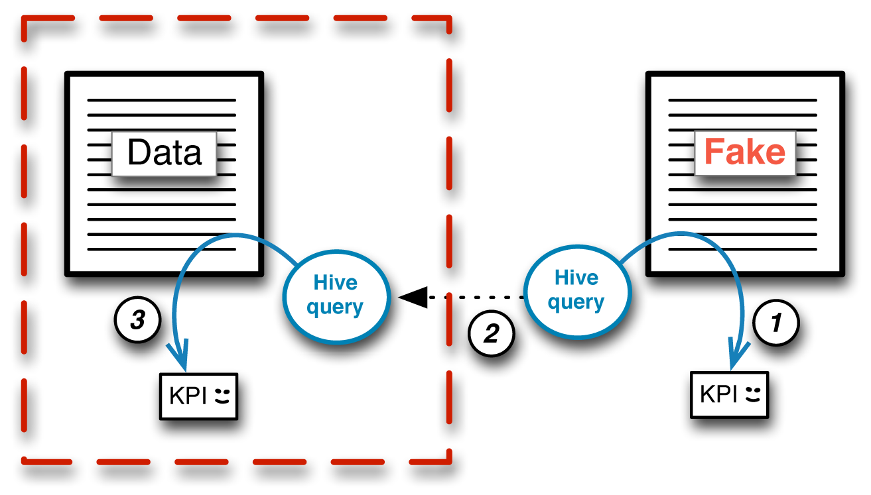
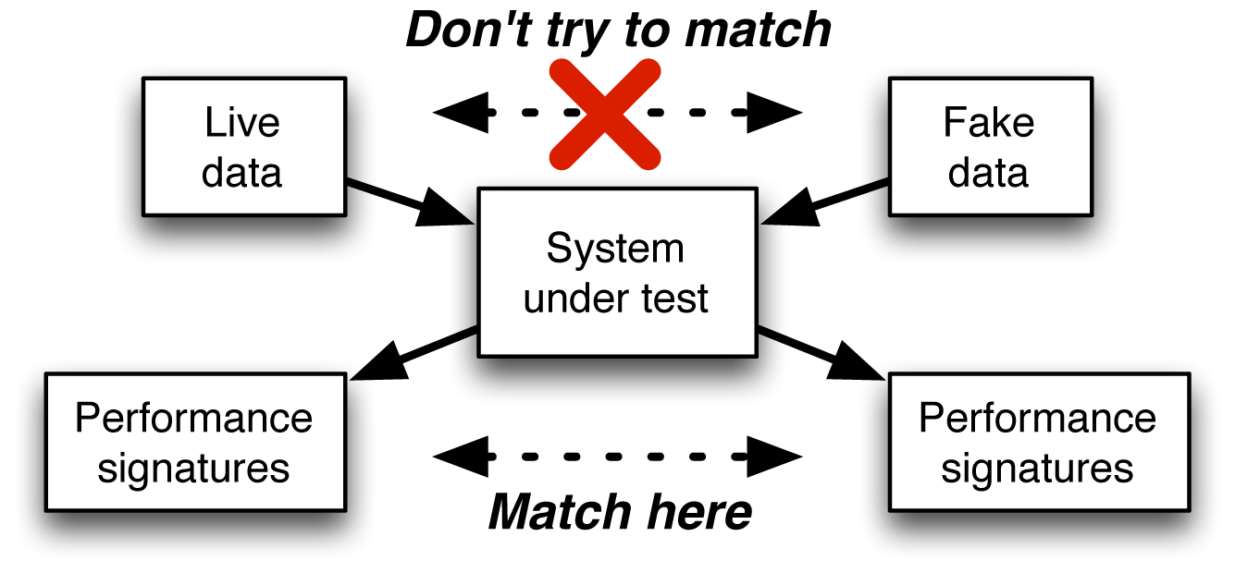
Big Data Security Concerns
1) Fake Data Generation
Most Significant Security Issue.
Reduces our ability to protect client information.
Reduces your ability to identify other issues.
Makes it difficult to identify fraud.
https://www.oreilly.com/library/view/sharing-big-data/9781491953624/ch04.html
Notes:
Notes:
Fake Data is one of the biggest challenges of Big Data in today’s world. No matter what state of the art system you implement to process the data and how much money and infrastructure you spend on your organization, it would be totally futile if the data that is to be processed is fake. This fake data is a significant security threat because it also reduces the ability of the organization to identify other important issues. It could lead to several false positives which would in turn cause the organization to waste money and resources.
References:
Smallcombe, M. (2020, June 24). 11 Big Data Security Concerns. Xplenty. https://www.xplenty.com/blog/big-data-security-concerns/
Bekker, A. (2021, May 31). Buried under big data: security issues, challenges, concerns. ScienceSoft. https://www.scnsoft.com/blog/big-data-security-challenges

Slide 5
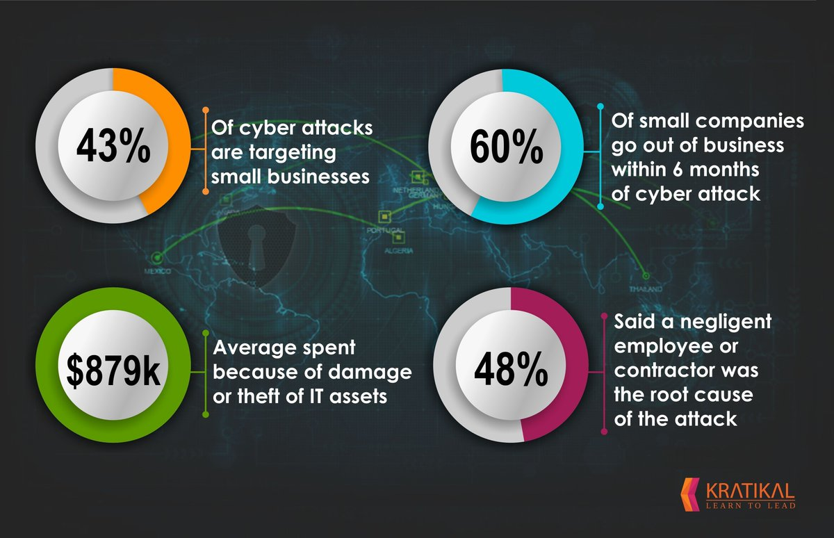
Big Data Security Concerns
2) Employee Negligence
Policies of the workplace should be updated.
The physical access must be secured.
The hardware must be disposed properly.
Strong communication mediums must be implemented.
https://www.kratikal.com/blog/cyber-security-awareness-employees/employee-negligence/
Notes:
Notes:
Employee negligence is straight up the biggest cause of cybersecurity attacks and data breaches. Basic human error such as losing documents and account credentials, ignorance of basic security practices, social engineering victim, etc account for nearly half of all the data breaches. There are several ways by which the company can reduce this risk. The company must implement strict workplace policy such as clean desk rule, strong password practices, use of VPN, etc. Moreover, the physical access of the company must be properly secured to stop anyone, but the employees access the office, and all sensitive documents must be properly locked and disposed after use. Proper communication protocols must be established to ensure that everyone is comfortable in reporting any security issue and action must be taken without any unnecessary delay.
References:
Smallcombe, M. (2020, June 24). 11 Big Data Security Concerns. Xplenty. https://www.xplenty.com/blog/big-data-security-concerns/
Robinson, P. (2020, June 18). Employee Negligence is Biggest Cyber Security Threat to US Companies. Lepide Blog: A Guide to IT Security, Compliance and IT Operations. https://www.lepide.com/blog/employee-negligence-is-biggest-cyber-security-threat-to-us-companies/

Slide 6
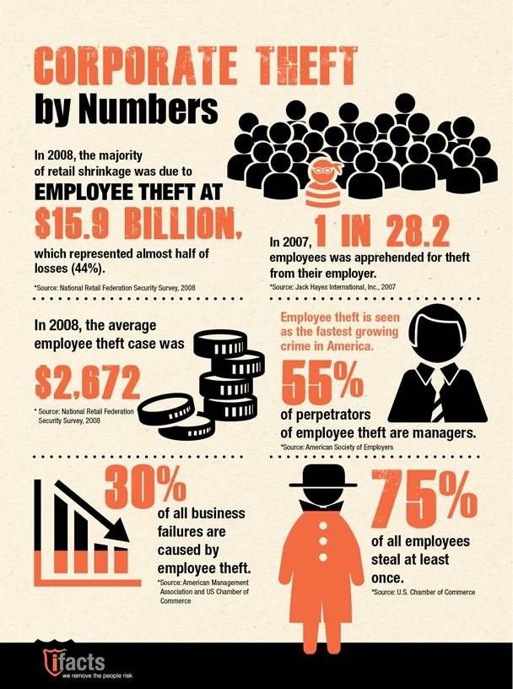
Big Data Security Concerns
3) Employee Theft
Accessing the most valuable data and checking who can access it.
Employees should be notified about policies and procedures.
Monitor and log data access by employees.
Implement strong ACL in the database.
Use multi-layer authentication.
https://za.pinterest.com/pin/363384263656868562/
Notes:
Notes:
Hackers are not the only ones who steal confidential information from the company. Employees can also steal information from company. In fact, more than 70 percent of departing employees admit to stealing some amount of company data and most of these thefts occur within three months of their resignation notice. The above chart shows some astounding statistics about Employee Theft. This is completely preventable if the company implements certain policies. The company should monitor the data which is accessed by the employees and also limit this data access to bare minimum. They should implement strong Access Control List to prevent the employees from accessing data that they shouldn’t. The company should also implement multi-factor authentication such as RFID Cards and security clearance to limit data access.
References:
BIA. (2021, January 7). Data Theft by Departing Employees: A Bigger Threat Than Hackers. https://www.biaprotect.com/webinars/data-theft-by-departing-employees-a-bigger-threat-than-hackers/
Smallcombe, M. (2020, June 24). 11 Big Data Security Concerns. Xplenty. https://www.xplenty.com/blog/big-data-security-concerns/

Slide 7
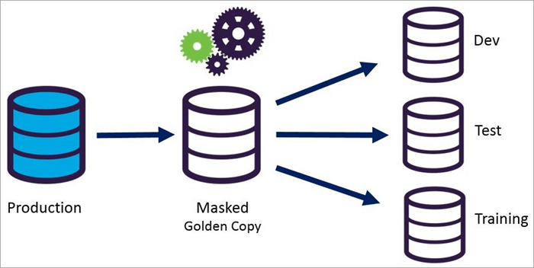
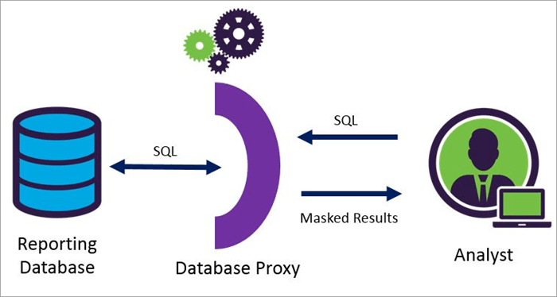
Big Data Security Concerns
4) Reversing Data Masking Measures
Create a false sense of security.
Malicious actors with the necessary equipment can sometimes reconstruct databases.
Endangering client data, sensitive corporate information.
Static Data Masking
Dynamic Data Masking
https://www.softwaretestinghelp.com/data-masking-tools/
Notes:
Notes:
In order to safeguard confidential information of the customers, companies tend to utilize the concept of Data Masking which allows them to separate confidential information of the clients from other information. If this process is done meticulously and with care, it is irreversible. However, hackers are employing powerful tools and equipment to reverse this process and steal the data. If the company stays in the false sense of security and does not regularly audit the system, it can endanger the data that is stored on the system.
References:
Smallcombe, M. (2020, June 24). 11 Big Data Security Concerns. Xplenty. https://www.xplenty.com/blog/big-data-security-concerns/

Slide 8
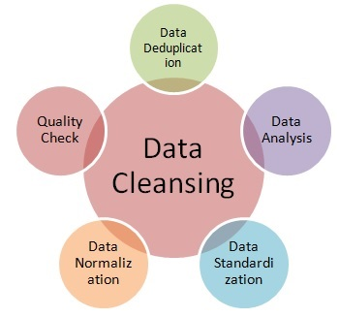
Big Data Security Concerns
5) Data Cleansing Problems
Data attributes can be inconsistent.
Automated data cleansing problem is based on a faulty model.
Reduce the quality of your database
Create the potential for breaches
https://www.rfwireless-world.com/Terminology/What-is-Data-Cleansing-or-cleaning.html
Notes:
Notes:
Big Data requires constant processing and cleaning of data to ensure that the database is relevant at all times. Hence, we employ automated tools and services for data cleansing. However, automated cleansing is not accurate all the times and might not work as expected every now and then. This can lead to database inconsistencies which can reduce the quality of the database and the results derived from it. Moreover, many data processing tools also retain some data while processing, if this data is not cleansed properly, it can lead to potential data breaches.
References:
Diez-Aguirre, J. (2019, December 19). GDPR and data cleansing: The hidden threat | Ricoh Insights. Insights - Empowering Digital Workplaces. https://insights.ricoh.co.uk/streamlining-processes/gdpr-and-data-cleansing-the-hidden-threat-that-most-of-our-clients-overlook
Smallcombe, M. (2020, June 24). 11 Big Data Security Concerns. Xplenty. https://www.xplenty.com/blog/big-data-security-concerns/

Slide 9
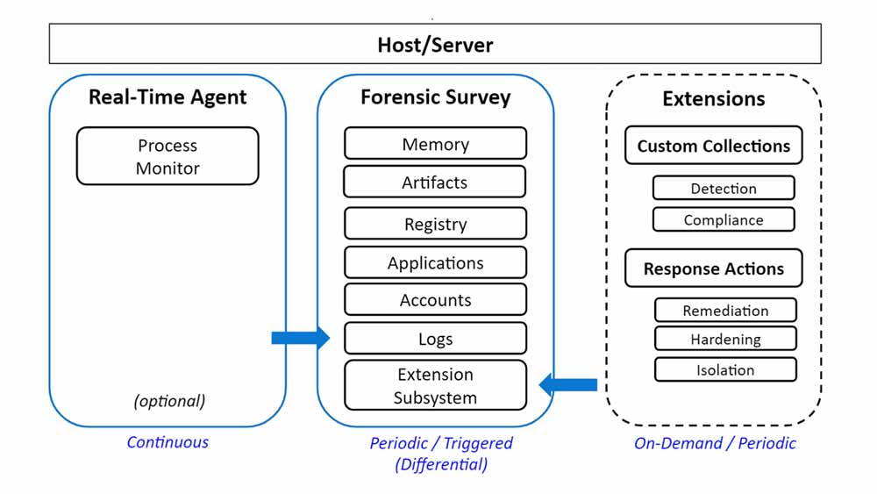
Big Data Security Concerns
6) Real-Time Security Compliance
Consists of real-time tools that ensure security compliance.
Consistently monitor processes.
Provides measures to safeguard data.
Choosing the right tool among many is challenging as a wrong tool can compromise security.
Breach detrimental as hackers get access to our databases.
A single false breach warning can result in wasted resources and the potential for overlooking actual breaches.
https://securityboulevard.com/2020/04/introducing-infocyte-real-time-security-continuous-threat-monitoring-for-endpoints-cloud/
Notes:
Notes:
Big Data relies on huge amount of data generated from the clients to function. As a lot of this information can be confidential, its security is the top priority of the company. The size of the data is also the reason for being targeted by hackers. To constantly prevent and thwart these attacks, the company is required to comply with the latest security regulations set by agencies and regulatory authorities. As these regulations are ever-changing, Big Data Companies rely on real-time tools to ensure security compliance. There are so many tools available in the market for this very purpose. However, not all tools are good, some might not be compatible with the system, and some might not be up to date with the regulations. This can lead to loopholes in the system and also false alerts.
References:
Smallcombe, M. (2020, June 24). 11 Big Data Security Concerns. Xplenty. https://www.xplenty.com/blog/big-data-security-concerns/

Slide 10
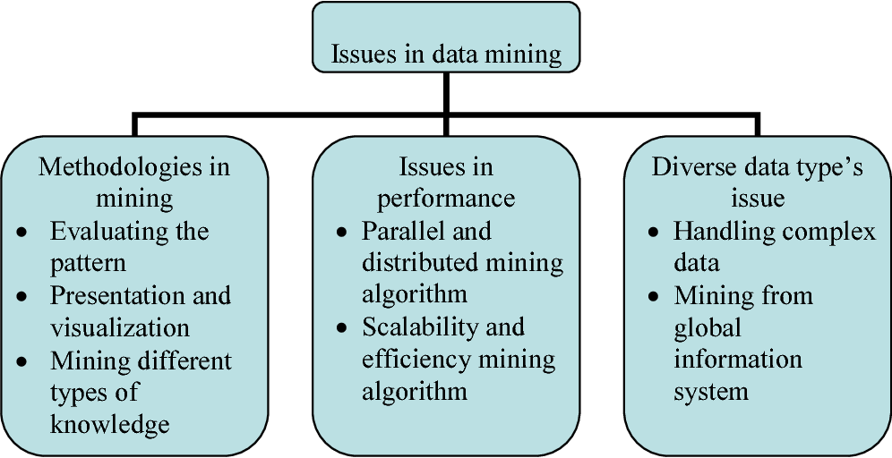
Big Data Security Concerns
7) Data Mining Issues
Powerful tool in helping better understand and utilize the data.
We can discover the patterns along with the statistics and machine learning.
Giving IT Specialists access to confidential data can lead to data theft and misuse.
For example, Cambridge Analytica breach gave hackers access to confidential data of millions of Facebook users.
https://www.semanticscholar.org/paper/Review-on-the-data-mining-technology-and-the-on-Liu-Huang/7467f733c057ad7e05b6a031ea130011a90298de
Notes:
Notes:
Data Mining is one of the most powerful tool used by Big Data Companies. It helps them understand and utilizes the data that they own by using complex statistical and machine learning processes to discover patterns and forecast trends. However, it is very risky to give these IT Specialists unsupervised access to all the data as it may lead to data theft and misuse. Moreover, the data can also be breached by hackers due to negligence of the employees. The biggest example of this will be the infamous Cambridge Analytica breach which gave hackers access to huge amount of data belonging to Facebook users.
References:
Hoffman, J. (2021, April 27). Most Common Data Mining Security Issues You Need to be Aware Of. WisdomPlexus. https://wisdomplexus.com/blogs/data-mining-security-issues/
Smallcombe, M. (2020, June 24). 11 Big Data Security Concerns. Xplenty. https://www.xplenty.com/blog/big-data-security-concerns/

Slide 11
Big Data Security Concerns
8) Lack Of Security Spending
Spending on protecting this data hasn’t necessarily risen concurrently.
Average spending is still below what cybersecurity experts recommend for effective security.
About 10 percent of a company’s IT budget should be devoted to data and cybersecurity.
Breaches are occurring with greater frequency every year, and as we find new ways to fight these problems, criminals will improve their infiltration methods.
https://www.researchgate.net/publication/235082256_Economic_Analysis_of_Cyber_Security
Notes:
Notes:
Data breaches are on a constant rise all around the world. We are hearing news that famous companies such as Microsoft, Facebook, etc. are being breached almost every month. Even though the security concerns of big data security are becoming more and more severe, the spending on protecting the data has not risen accordingly. The average spending on security by companies is still below the recommended amount by cybersecurity experts. According to cybersecurity experts, a company should spend at least 10% of their budget on data security. However, as you can see in the graph, the average of cybersecurity spending is below 6%.
Still this data was collected pre-pandemic and I expect these numbers to improve drastically as we are seeing increased awareness about Cybersecurity after the pandemic.
References:
Tonar, R., & Talton, E. (2018, April 28). A Lack Of Cybersecurity Funding And Expertise Threatens U.S. Infrastructure. Forbes. https://www.forbes.com/sites/ellistalton/2018/04/23/the-u-s-governments-lack-of-cybersecurity-expertise-threatens-our-infrastructure/?sh=25d995d049e0
Smallcombe, M. (2020, June 24). 11 Big Data Security Concerns. Xplenty. https://www.xplenty.com/blog/big-data-security-concerns/

Slide 12

Big Data Security Concerns
9) Lack of Security Audits.
Helps to Identify security gaps.
Lack of time , resources, security assessment can lead to task ignored.
Must be done monthly or quarterly.
Data obtained could be at risk so imperative that high quality is performed.
https://www.compuquip.com/blog/when-to-conduct-a-security-audit
Notes:
Notes:
Failure to complete necessary audits is one of the biggest data security threats. Most companies perform security audits just for the sake of regulatory compliance. Security Audits can help the companies discover security gaps which were overlooked previously. This can help them prevent severe data breaches. However, companies often overlook the importance of these audits, and they are often put off or ignored completely. According to security experts, security audits must be conducted monthly or quarterly, but most companies only conduct them yearly or not at all.
References:
Zola, A. (2020, April 17). A Security Audit Is Critical to Mitigate Risk. Security Boulevard. https://securityboulevard.com/2020/03/a-security-audit-is-critical-to-mitigate-risk/
Smallcombe, M. (2020, June 24). 11 Big Data Security Concerns. Xplenty. https://www.xplenty.com/blog/big-data-security-concerns/

Slide 13
Conclusion
We can have serious risks if we don’t consider the threats above.
The cost of securing your clients’ information after a breach or data loss can be significant, but the damage to your brand's image could prove incalculable.
So, if our business is in the domain of the big data than we must consider these options as serious.

